Slide 1
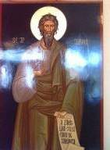
MYTHEUROLOGY
ȘCOALA GIMNAZIALĂ “SFÂNTUL ANDREI” SECONDARY SCHOOL “SAINT ANDREW”
SHORT PRESENTATION

Slide 2
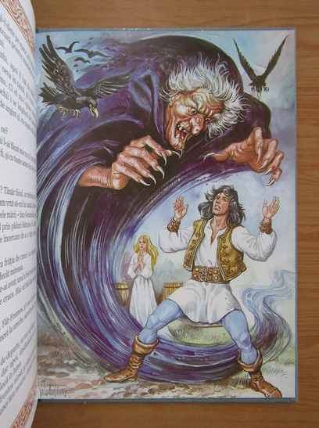
Făt Frumos
Prince Charming is the hero character in Romanian mythology. In most stories, he battles dragons and witches in order to free his beloved, Ileana Cosânzeana.

Slide 3
Qualities:
Prince Charming has all the necessary qualities of a hero: courage, justice, physical and spiritual strength, intelligence, steadfast love. This young man also has some magical qualities. He always keeps his oath to the emperor he serves.

Slide 4
Missions
In many stories Prince Charming has to free the chosen one of his heart, princess Ileana Cosânzeana. Prince Charming must overcome overwhelming trials and obstacles for the capabilities of a normal person, but he is always able to get trough all the difficulties.

Slide 5
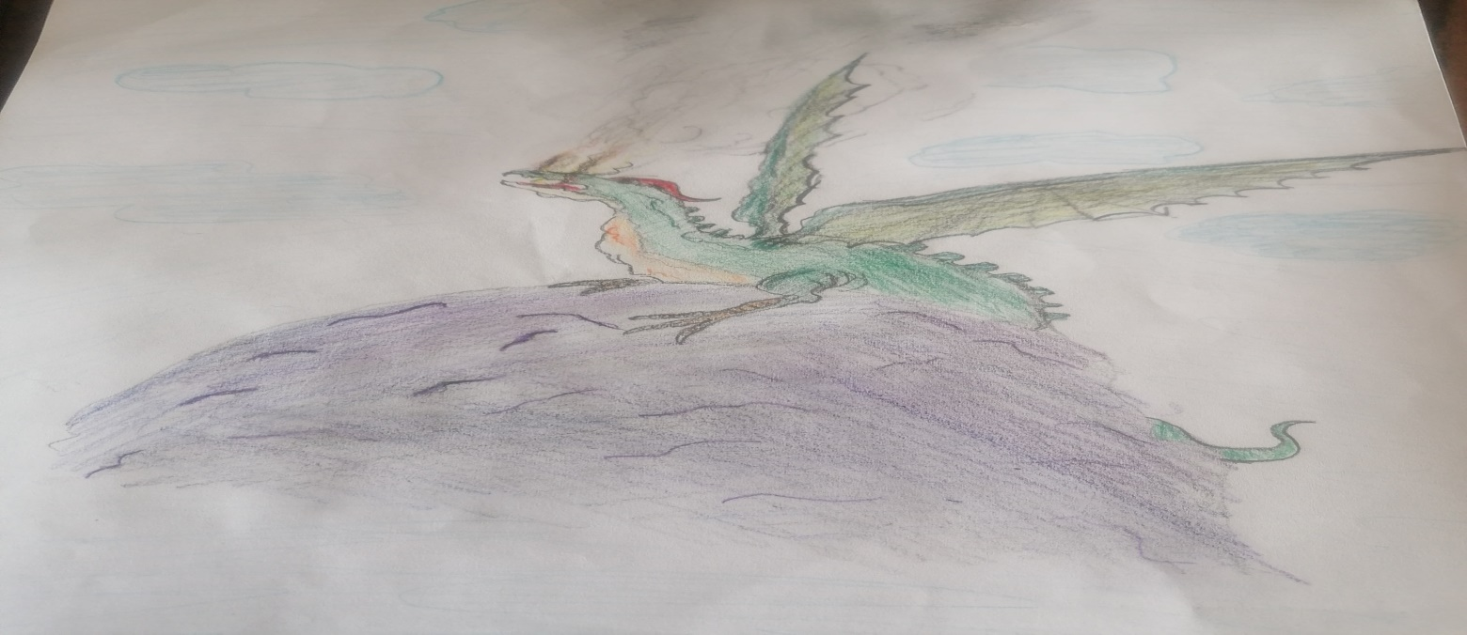
He fights different monsters such as snakes, dragons and witches.

Slide 6
Companionship:
He travels through our world and the underworld( the other realm) on the mischievous horse that gives him advice.

Slide 8
In literature
Prince Charming passed from folklore to Romanian literature. This character is often found in stories and poems by famous Romanian writers such as Mihai Eminescu, Ion Creangă, Petre Ispirescu.

Slide 9
Vlad Țepeș
Vlad Țepeș, also called Vlad the Impaler or Dracula, by the foreigners, ruled in Wallachia in the 1448, 1456-1462 and 1476. According to the modern legend, he was born in Sighișoara in the Transylvanian Voivodeship, being the son of Vlad Dracul and a Transylvanian noblesse. During his reign, Wallachia obtained its temporary independence from the Ottoman Empire ( the Empire of Turks).

Slide 10
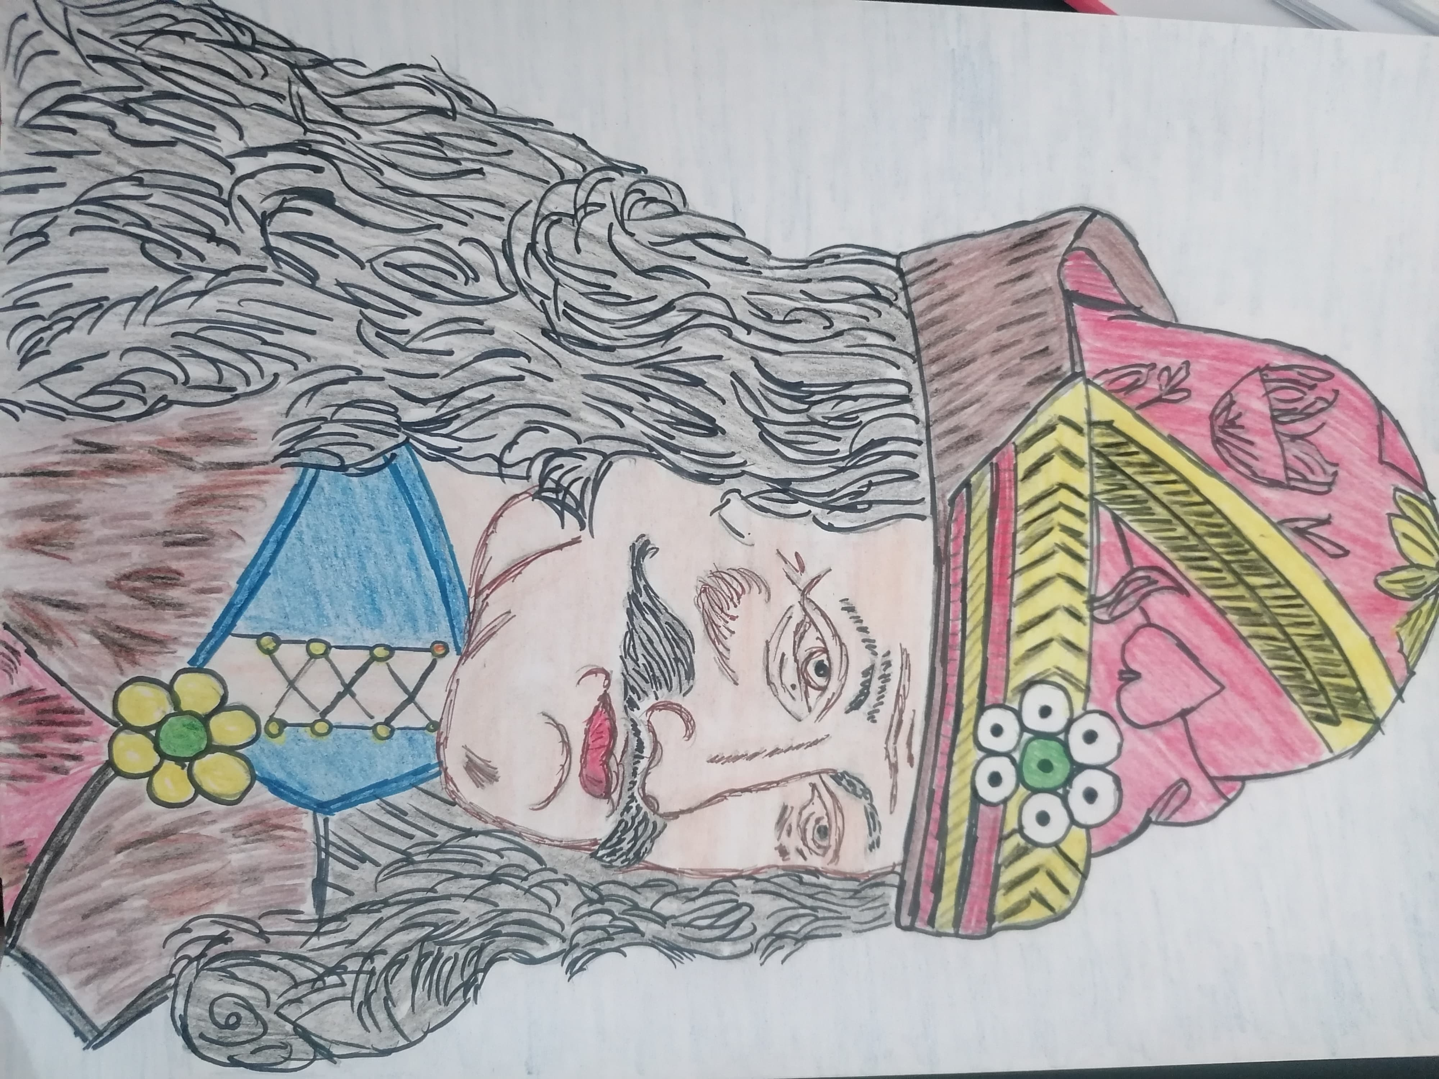

Slide 11
Vlad Țepeș became famous for his severity and because he used to impale his enemies. Vlad, also called The Impaler, was “a gentleman without a doubt of terrible cruelty” who had a habit of impaling his enemies or those who disobeyed him within the country.

Slide 13
It is said that as soon as he became the ruler, in 1456, he ordered the gathering of all thieves and beggars, locked them in a house and after he feasted them, he set the house on fire. He also impaled rebellious or disobedient boyars .

Slide 14
The origin of the nickname “Dracula” and “the Impaler” were received into the Order of the Dragon. The Order could be compared with that of The Knights of Malta or with that of the Teutonic Knights ( a religious German Catholic order formed at the end of the 12th century).

Slide 16
The character Dracula from the book "Dracula" by Bram Stoker is not directly based on the reign of Vlad Drăculea, but is a fiction that takes place in Transylvania and England in the 19th century. From success novel, Transylvania is associated with the fictional character Dracula.

Slide 18
The Irish writer Bram Stoker could consult some of those engravings at the Royal Library in London Saxons from the 15th century, which were also found in the collections of the British Museum, in which Vlad the Impaler is described as a monster, a vampire who drinks human blood and a great lover of cruelty.

Slide 19
The character Dracula is not directly based on the reign of Vlad Drăculea, but is a fiction that takes place in Transylvania and England in the 19th century. Bran Castle, a modern-day tourist attraction in Transylvania that is often referred to as Dracula's castle, was never the residence of the Wallachian prince.

Slide 21
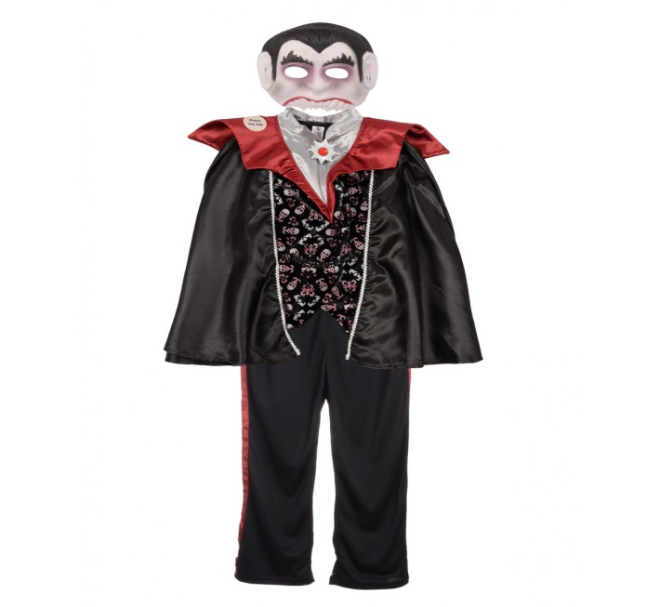
Dracula has become one of the best known fictional characters in the world. Due to his longstanding fame, Dracula continues to be a popular choice for a Halloween costume.

Slide 23
Baba dochia
Baba Dochia (or Baba Odochia) is one of the most important characters in Romanian mythology. Some theories claim that the name would be related to the Holy Martyr Evdokia celebrated in the old style calendar on March 1st.

Slide 24
Baba Dochia is the name of a Romanian mythical figure who brings with her the end of the cold winter and the beginning of the spring. Her holiday of the same name is celebrated in Romania on March 1st with the exchange and wearing of mărțișor (a small piece of jewelry tied to a braided cord of white and red thread). The tradition of giving friends red-and-white interwoven strings, brings health and happiness during the year and is a reminder that spring is near.

Slide 25
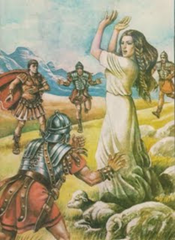
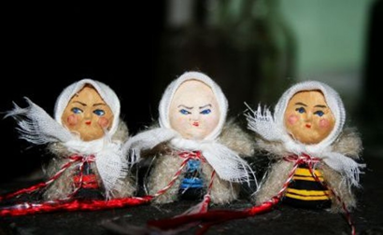
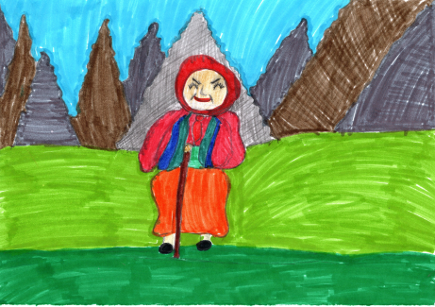
The feisty old lady Dochia, called in Bassarabia as well as in some parts of Muntenia, Baba Marta, always had an aura of mystery around her.
There are several versions about the legend of Baba Dochia, but all of them finally explain the changing weather at the beginning of March ( by changing her nine clothes) and the tradition of wearing Mărțișor in these period of the year.

Slide 26
A folk myth associates the nine wool coats taken down by Baba Dochia with the first nine days of March. It is said that her spirit haunts the Earth between March 1 and March 9, bringing snowstorms and cold weather. Tradition says that on the first day of March, women must choose one of the first nine days of the month as a “babă” (”old woman”).

Slide 27
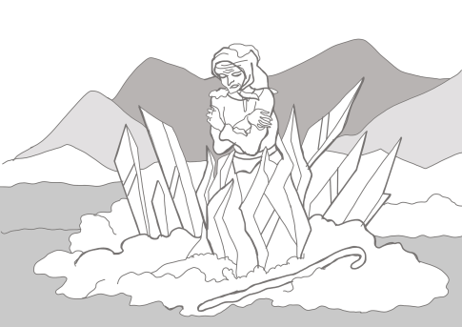
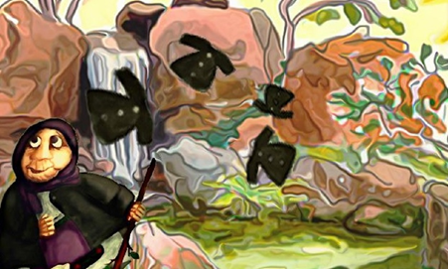
If the day they chose turns out to be warm and pleasant, then they will age beautifully and their spirit will be forever young. But if the day turns out to be cold, then they will become bitter and turn into a witch.
Baba Dochia and her 9 woolen coats remained in popular culture as a harbinger of the weather and spring and became, in time, a story to scare children.

Slide 28
In the past, Baba Dochia's days were observed with sanctity, as a true celebration, so that the cold would not bring damage to the fields and people would be protected from storms, the rain would be enough for the fields of the villagers and the year would be a rich one. It was also believed that Baba Dochia had the power to ward off drowning, to help animals gain weight and to protect cattle from disease.

Slide 29
Authors

Slide 30
THANK YOU FOR TIME AND ATTENTION !

