Slide 1
Polish Heroes of legends
Miejska Szkoła Podstawowa nr 6 im. Królowej Jadwigi w Knurowie

Slide 2
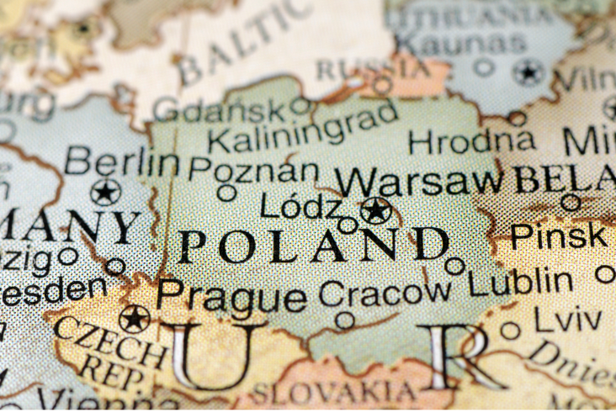
Wawel Dragon- the most popular Polish legend
The legendary dragon, whose hide was a cave called the Dragon's Lair at the foot of the Wawel Hill in Cracow.

Slide 3
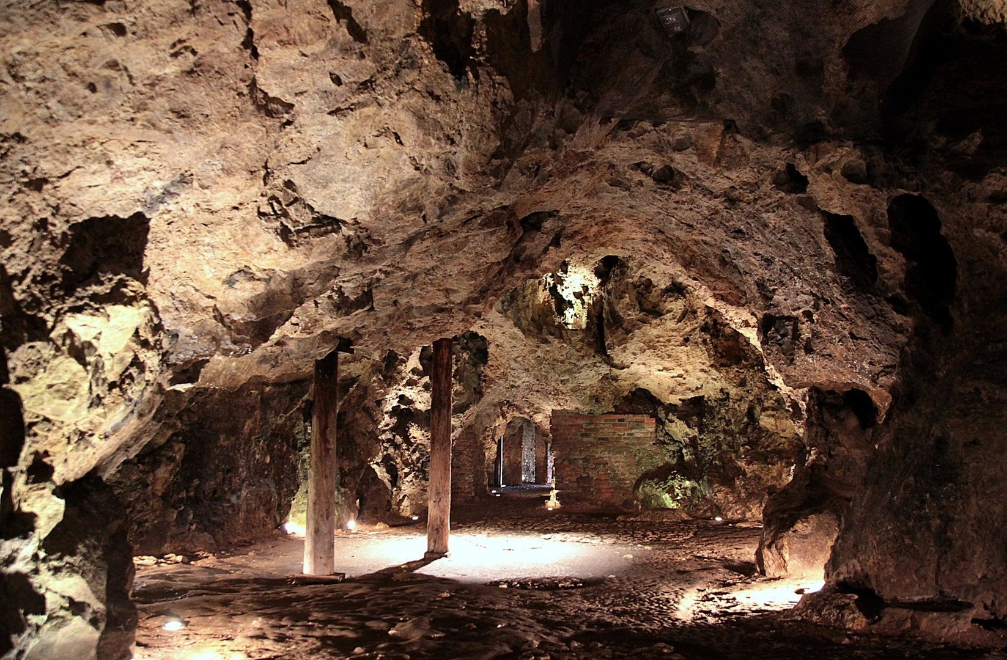
Dragon’s Lair

Slide 4
DESCRIPTION OF WAWEL DRAGON
It is a big, green and scary creature.
It has got scales all over its body.
It has got yellow eyes, green wings and a long tail.
It has got horns and sharp claws.
It has got big and sharp teeth.

Slide 5
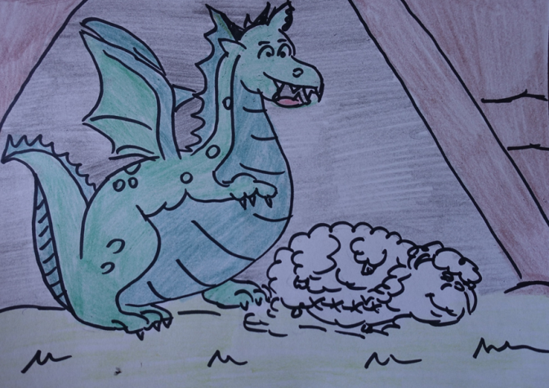
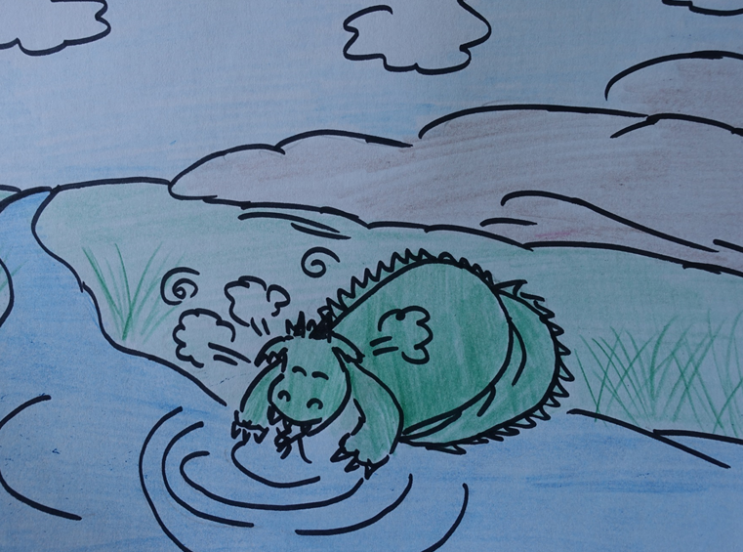
The story of Wawel Dragon
Once upon a time there was a dragon, which lived in a den under Wawel Hill and terrorised all people of King Krak’s town.
They had to feed it by giving him sheep.
No knight could defeat it until one day a shoemaker called Skuba killed it using a trick.
He stuffed a sheep with sulphor and pu it in front of dragon’s lair. The dragon ate the sheep.
Immediately, it felt a bad pain and burning in the throat. To quench his thirst, the Dragon started to drink from the Vistula River.
However, as water cannot extinguish burning sulphur, the gases produced by the fires inside him made the beast explode.

Slide 6
Wawel Dragon

Slide 7
Dragon’s super powers:
The Wawel Dragon can fly.
Above the clouds it is invisible.
It breaths fire.
It is very strong.

Slide 8
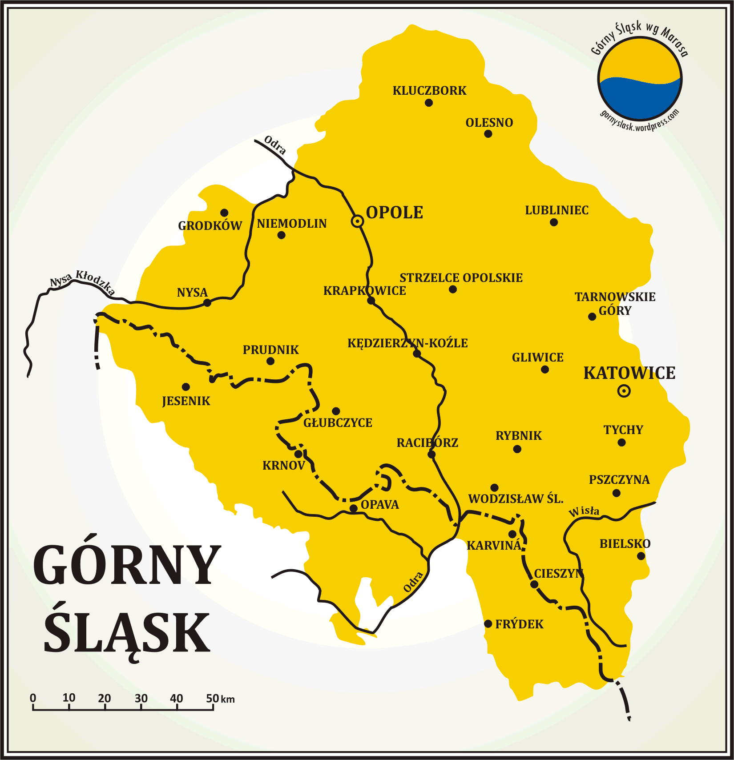
UPPER SILESIA
In Upper Silesia- the region of Poland were we live- there are large deposits of coal underground. In the past, this was the main industry of the region.

Slide 9
COAL MINE IN KNURÓW
Towns and cities were built around the coal mines. For people living here mining was the only work. It has been very hard and dangerous since now.

Slide 10
UNDERGROUND OF THE COAL MINE IN KNURÓW

Slide 11
COAL MINE

Slide 12
The Treasurer Skarbek
Due to hard and extremely dangerous work Skarbek people tell the story about the ghost that looks after all coal miners and warns them about the danger.

Slide 13
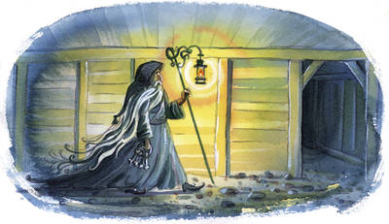
DESCRIPTION OF THE TREASURER
He often looks like human.
He is an old man with long gray beard.
He holds a wooden stick in his hand and a mining lamp.
He wars a long coat with a hood.

Slide 14
The Treasurer

Slide 15
His super powers:
He is invisible.
He is strict for lazy people, but fair.
He prizes hard-working people.
He can show you the way in the darkness.
He knows when there will be and explosion underground.

Slide 16
Jorguś – coalminer
IT IS THE SILESIAN VERSION OF NAME „GEORGE”.
THIS IS A POOR BOY WITH A BIG HEART, WHO WORKS HARD IN THE COAL MINE.

Slide 17
The coal miner

Slide 18
DESCRIPTION OF JORGUŚ
He is a young boy.
He is short with fair hair.
He is dressed in a mining uniform.
He is hard-working .
He is responsible.
He is brave and honest.

Slide 19
JORGUŚ - COAL MINER
His super powers are his character features.

