Slide 1
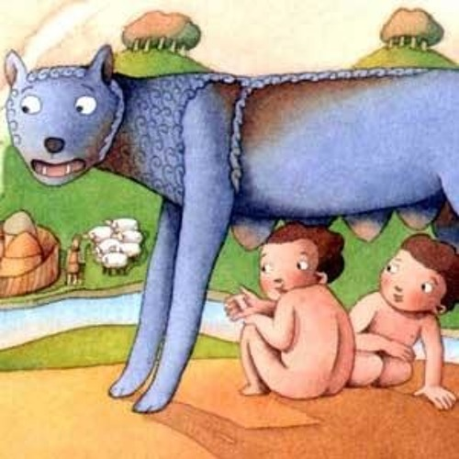
One Italian Hero…
ROMULUS

Slide 2
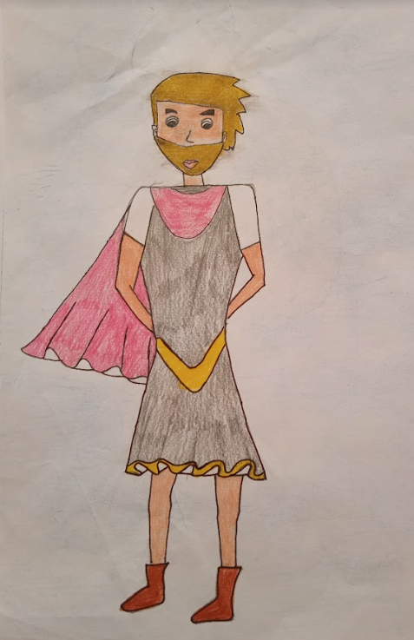
The legend of Romulus and Remus
The legend tells of twin brothers called Romulus and Remus. Their mother is Rhea Silvia, the daughter of king Numitor in Albalonga, and their father is Mars, the God of War.
King Numitor has a brother, Amulius, who wants to be the king so much that he takes the throne for himself, chasing away his brother who was supposed to be the real king.
After that he tries to stop Rhea Silvia from having any children of her own because they can try to take back the throne.

Slide 3
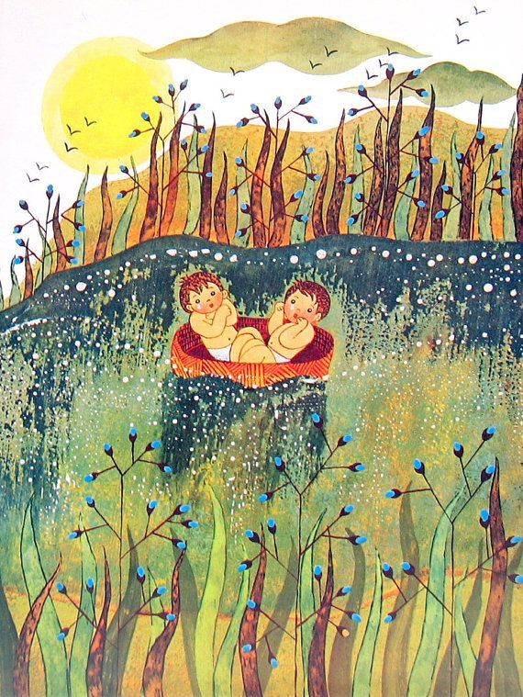
After Romulus and Remus birth, Amulius is shocked and very angry.
In his rage he puts the twin boys into a basket and throws them into the river Tiber. He wants nothing more to do with them.
After the twins have floated down the river in their basket, a mother wolf sees them and rescues the two babies. She cares for the boys feeding them with her own milk.
Once Romulus and Remus get bigger, they are taken home by a shepherd called Faustulus. He and his wife look after them in their home until they became adults.

Slide 4
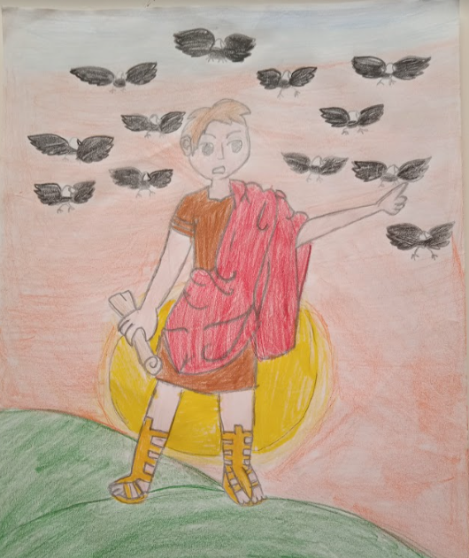
One day Faustulus tells them who they really are so Romulus and Remus plan to kill Amulius, to reclaim the throne for their own family and they give back the crown to their grandfather Numitor.
After some years they leave their small town, Albalonga, to build a bigger town.
But they disagree about where to build it.
Romulus chooses the Palatine Hill, but Remus prefers the Aventine Hill.
When they can’t resolve the dispute, they agree to seek the gods' approval: they must spot as many vultures as possible at sunset. Remus first sees six birds but soon afterward Romulus sees 12 and claims to have won divine approval. They dispute the result. They argue without finding a solution. Romulus decides to start building his own city anyway.

Slide 5
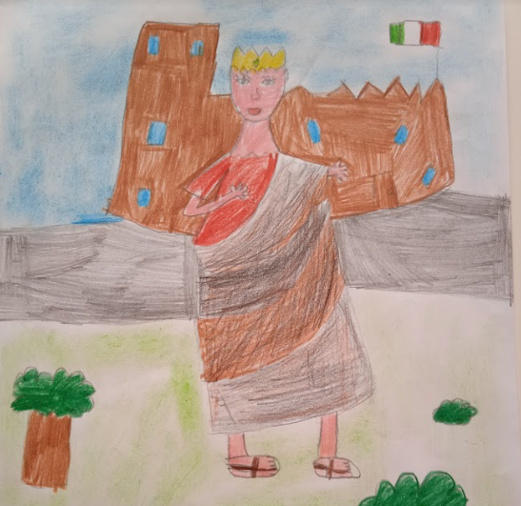
One day Remus comes and visit his brother and he mocks Romulus city for its low walls.
Romulus is so infuriated that he throws a big stone against his brother and he kills him instantly. He declares that no one else had to dare to make fun of his city.
It was called Rome in his honor.
He continues to build up his city and he becomes the king in 753 BC.

Slide 6
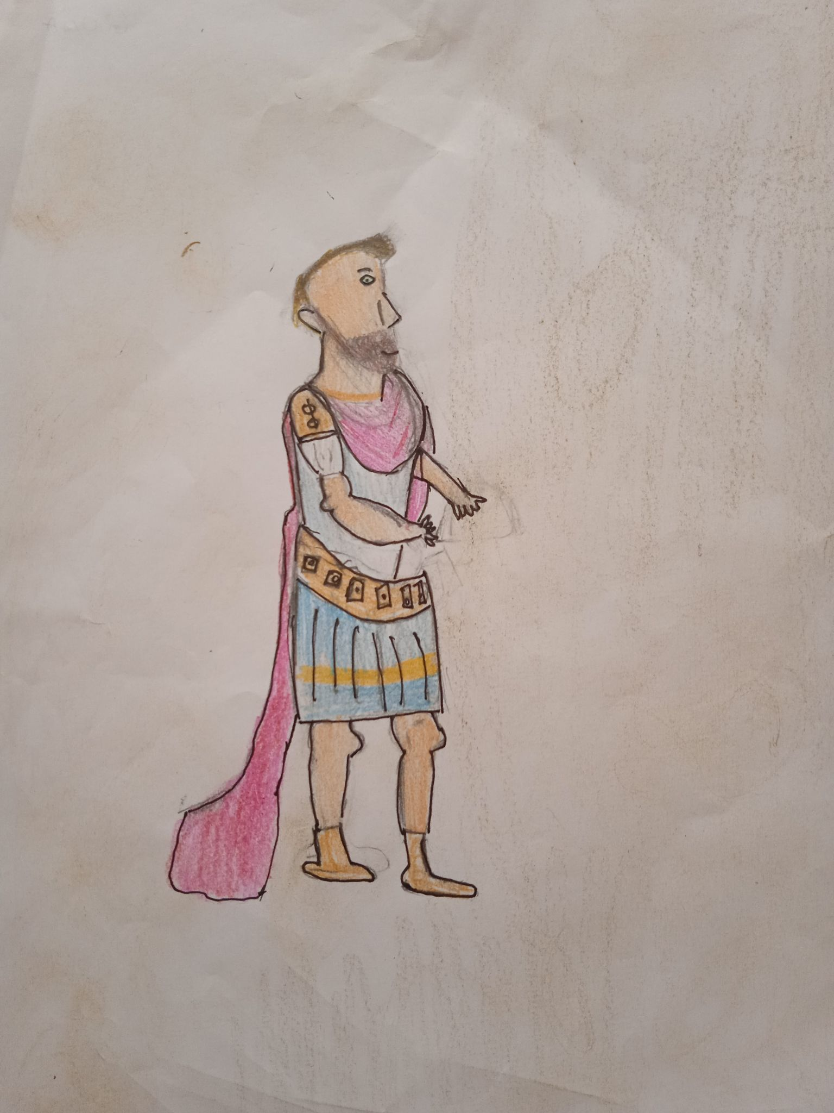
Romulus description
Rhes Silvia, King Numitor’s daughter, and the God Mars are Romulus’ parents.
He’s got a twin brother named Remus.
He is a special man because he is the son of a god.
When he was a child, he was bigger than the other children and very strong.
In our drawing he has got short, blonde hair, green eyes, a long nose and a brown beard. He has got a big neck and muscles on his arms. He wears a red cloak with golden medallions, a light blue tunic, sandals and a precious golden belt.

Slide 7
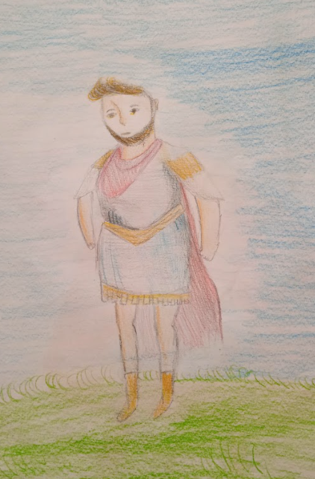
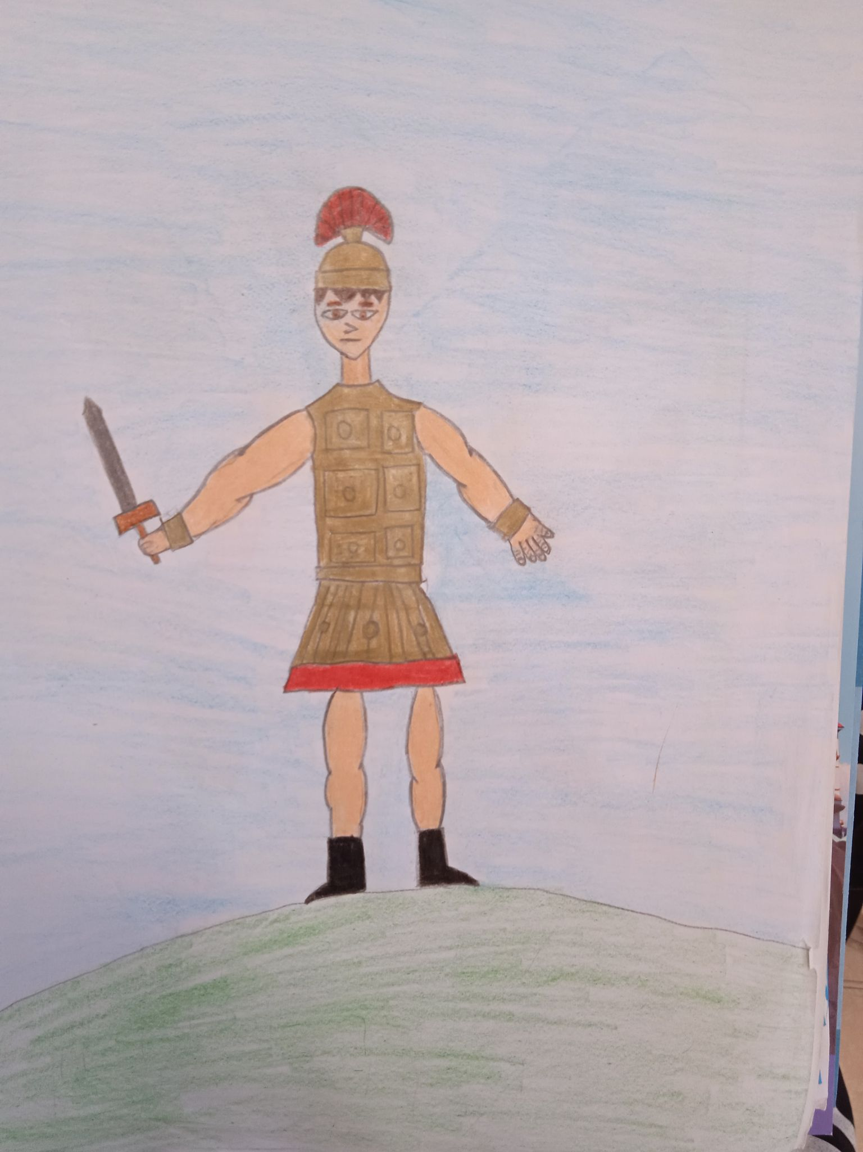
He is courageous and powerful.
He is intelligent and cunning. Sometimes he is arrogant and he seems ruthless when he hits his brother.
He always wants to be the winner.
He is a great fighter, a conqueror, danger does not frighten him.
He is proud and decisive and knows how to lead his group.
It is not a coincidence that he became the first king of Rome.

