Slide 1
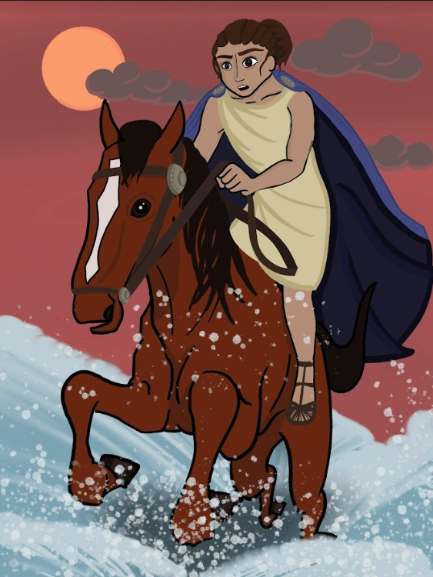
The Mith
of Cloelia

Slide 2
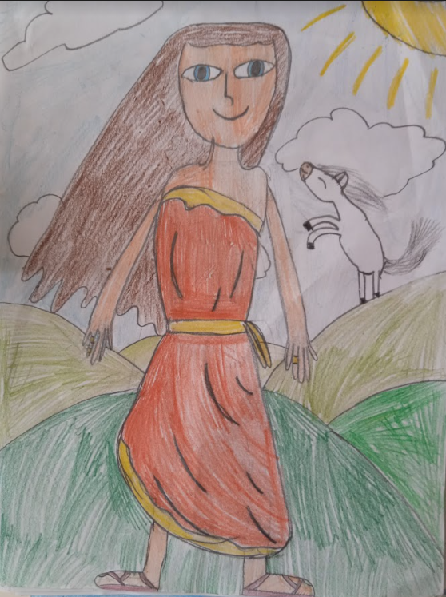
Cloelia’s Myth
The story of Cloelia's bravery takes place in Rome, in 506 BC.
Cloelia lives in a noble family of Roman Patricians.
At that time Romans were struggling against the Etruscans headed by Lars Porsena, the king of Clusium.
After a brief conflict just outside Rome, a peace treaty is drawn up between Porsena and the Romans.
The Romans agree to give 200 hostages in exchange for Porsena withdrawing his troops from the city.
Among the hostages there is a number of children and women including Cloelia.

Slide 3
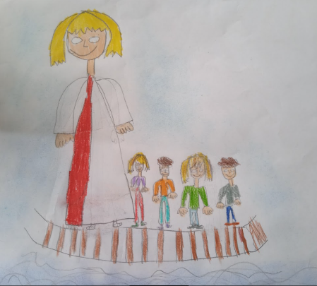
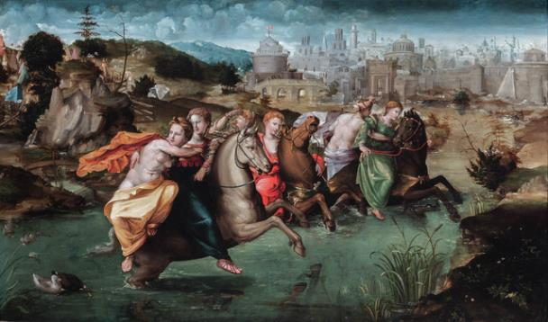
When the hostages arrive in the Etruscan camp, Cloelia plans an escape. She proposes to his peers to take advantage of the distraction of the Etruscan soldiers to throw themselves into the Tiber River.
They cross the river swimming and soon they reach Rome.
Porsena sends a message to the Romans reminding them that the treaty would remain intact if Cloelia and the other hostages were returned.
The Romans keep their word and return the hostages.

Slide 4
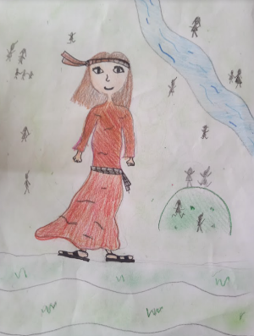
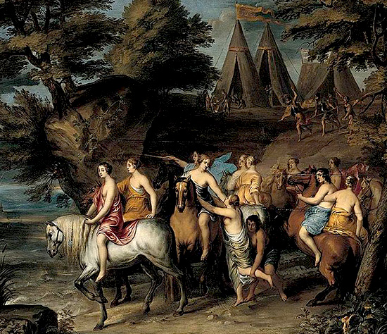
Porsena acknowledges that the Romans kept the agreements made and is impressed by Cloelia's courage.
So he decides to let her free and permits her to choose a number of hostages to take with her.
Cloelia makes her decision by considering the best worst option. The boys are very young and, without the protection of their families, could be the most helpless and vulnerable.

Slide 5
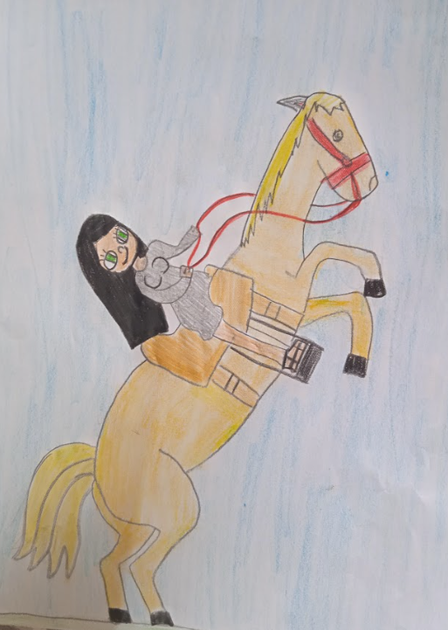
So she chooses to free the kids. Porsena appreciates Cloelia's noble gesture and decides to free all the hostages.
He gives her a beautiful white horse to return to Rome.
The crowd welcomes Cloelia with enthusiasm and celebrates the end of the war.
Cloelia becomes a folk hero. The Romans reward her and build an equestrian statue in her honour, set up on the summit of the Sacred Way:
the first Roman woman to be presented on horseback in statue form, proud and without any fear.

Slide 6
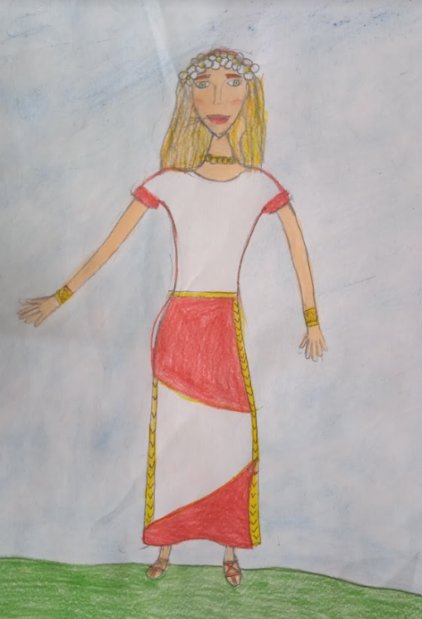
Cloelia's description
Cloelia is a noble teenager that lives in a family of Roman Patricians.
She is tall and slim.
She has got long, straight, blonde hair, her eyes are bright, blue and big, her skin is light as milk, her eyebrows are dark.
She wears a long, white, soft dress, a golden belt, two golden precious circles on her shoulders and pink shoes.

Slide 7
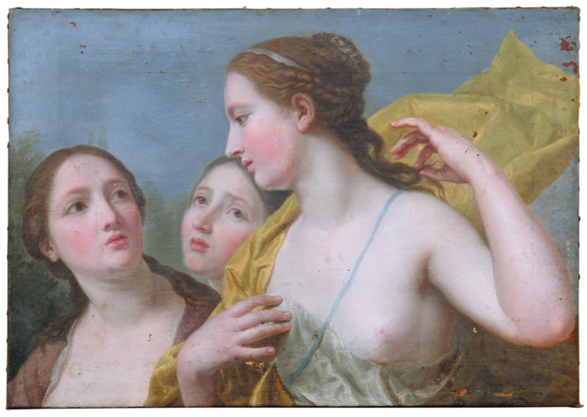
She is elegant and gentle.
She is proud and decisive when she looks for a way to escape together with the other hostages and she dives first into the river without hesitation. She is intelligent and brave.
She is altruistic, she takes care for the weakest, for children because they miss their family.
She is not afraid to face the enemy and she takes responsibility of her actions to save the others.
She is a heroine because she fights for freedom.

Slide 8
