Slide 1
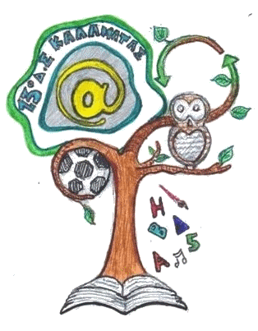
The Greek Heroes
13th Primary School of Kalamata

Slide 2
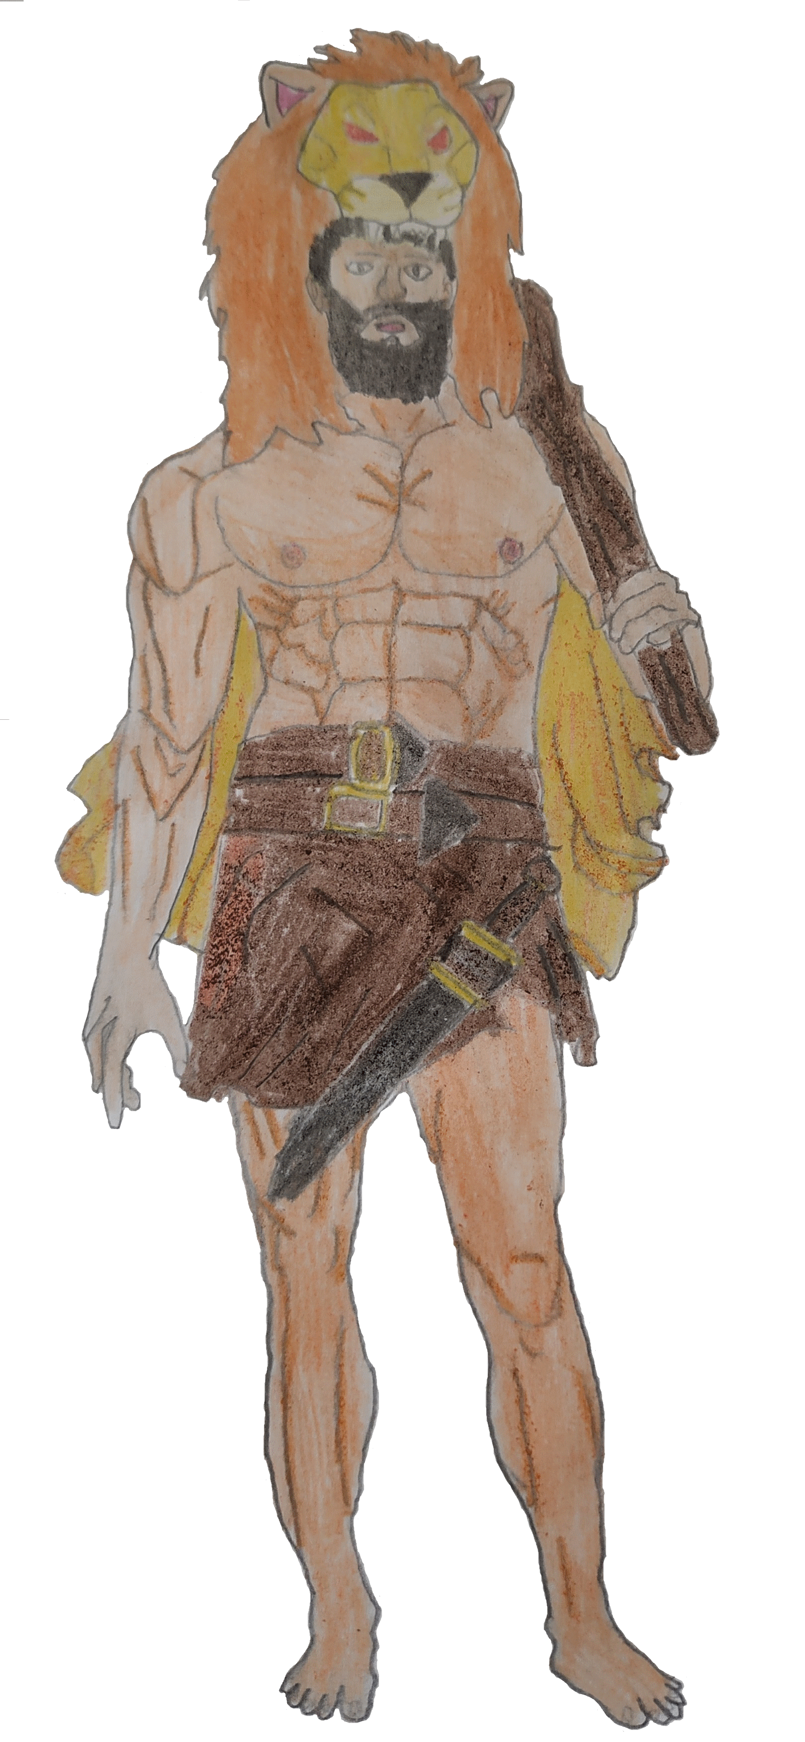
Hercules
Hercules was the son of the god Zeus and a mortal queen, Alkmene, who was married to Amphitryon.
He was the greatest hero of Greek mythology.
A half-man and half-god with superhuman powers destined to free humans from evil.

Slide 3
Hercules
He faced the wildest beasts and forces of nature.
As a man he had many gifts. He was fair, kind-hearted and brave.
He helped people and he was famous for his kindness.
He was also fearless and invincible and his labors were unforgettable.

Slide 4
The most important labors of Hercules
The slay of Nemean lion

Slide 5
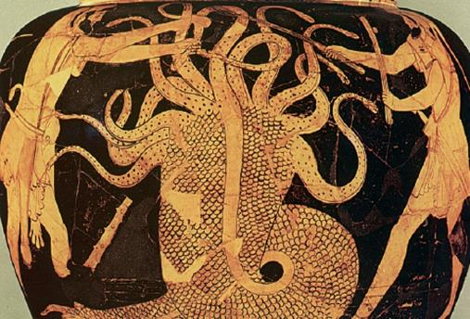
The most important labors of Hercules
The slay of the nine-headed Lernaean Hydra

Slide 6
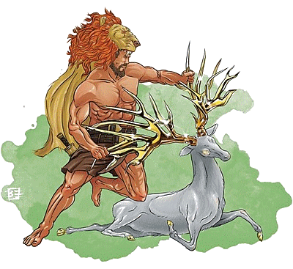
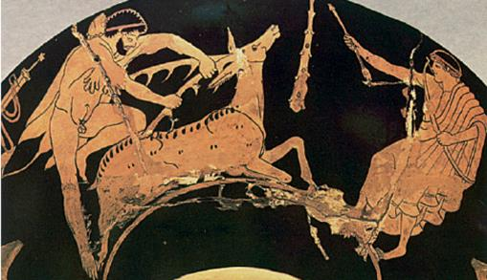
The most important labors of Hercules
The capture of Ceryneian Hind.

Slide 7
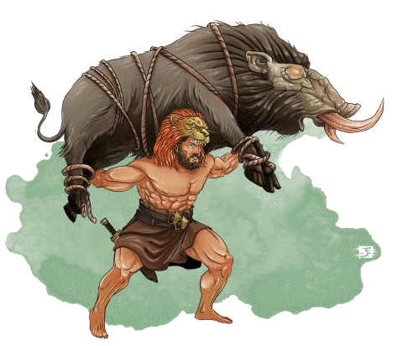
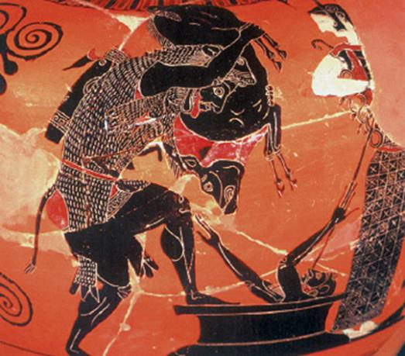
The most important labors of Hercules
The capture of the Erymanthian Boar

Slide 8
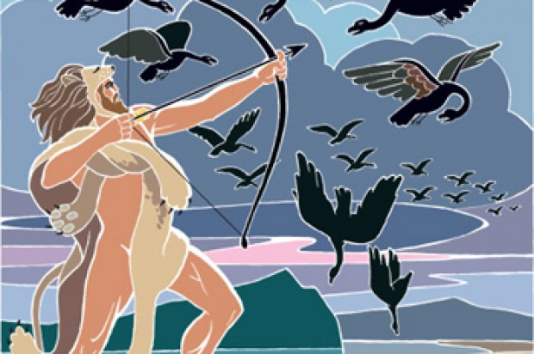
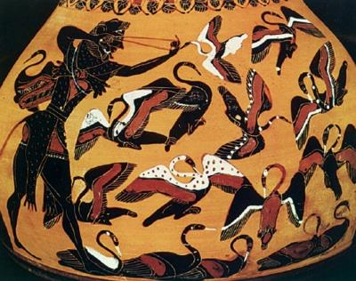
The most important labors of Hercules
The slay of the Stymphalian Birds

Slide 9
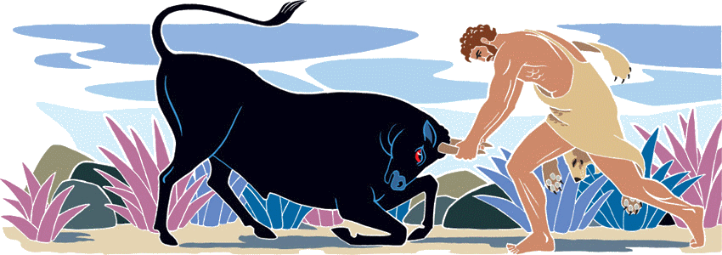
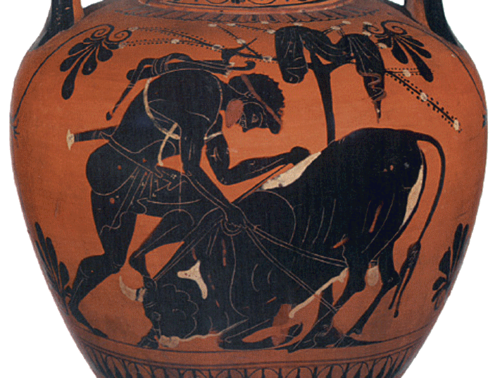
The most important labors of Hercules
The capture of the Cretan Bull

Slide 10
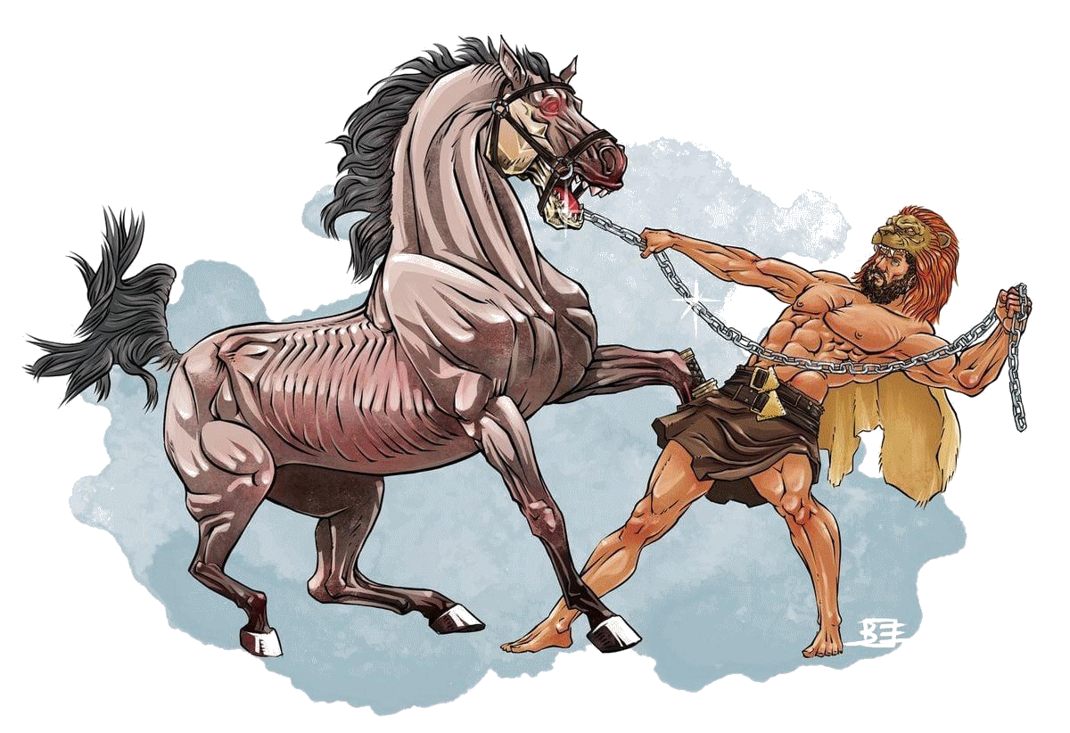
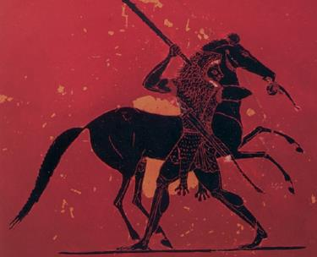
The most important labors of Hercules
The steal of the Mares of Diomedes

Slide 11
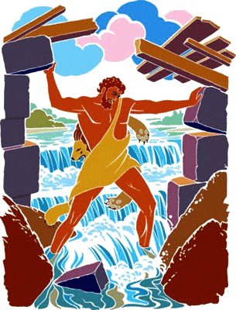
The dung of Augeas
The fifth labor of Hercules was to clean up the dung of the stables of Augeas.
Augeas was the king of Ilis and he had in his possession 3000 oxen in huge stables that had not been cleaned for 30 years.
Eurystheus ordered Hercules to clean the stables in one day in exchange for a tenth per cent of the flock.
Hercules cleaned the manure by digging two ditches in the foundations of the stables and diverting through them the waters of the Peinios River and the Alpheios River.

Slide 12
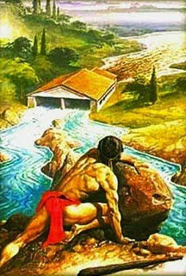
The dung of Augeas
The waters of these two rivers carried away all the manure.
Having finished his task within the fixed time, Hercules asked the king for his reward, but he refused to give it to him.
In the trial that followed to resolve the dispute, Phyleas, the son of Augeas, testified in favor of Hercules and for this reason he was expelled from Elis along with Hercules by royal order of Augeas.
Several years later Hercules returned to Elis, conquered the city and killed Augeas.

Slide 13
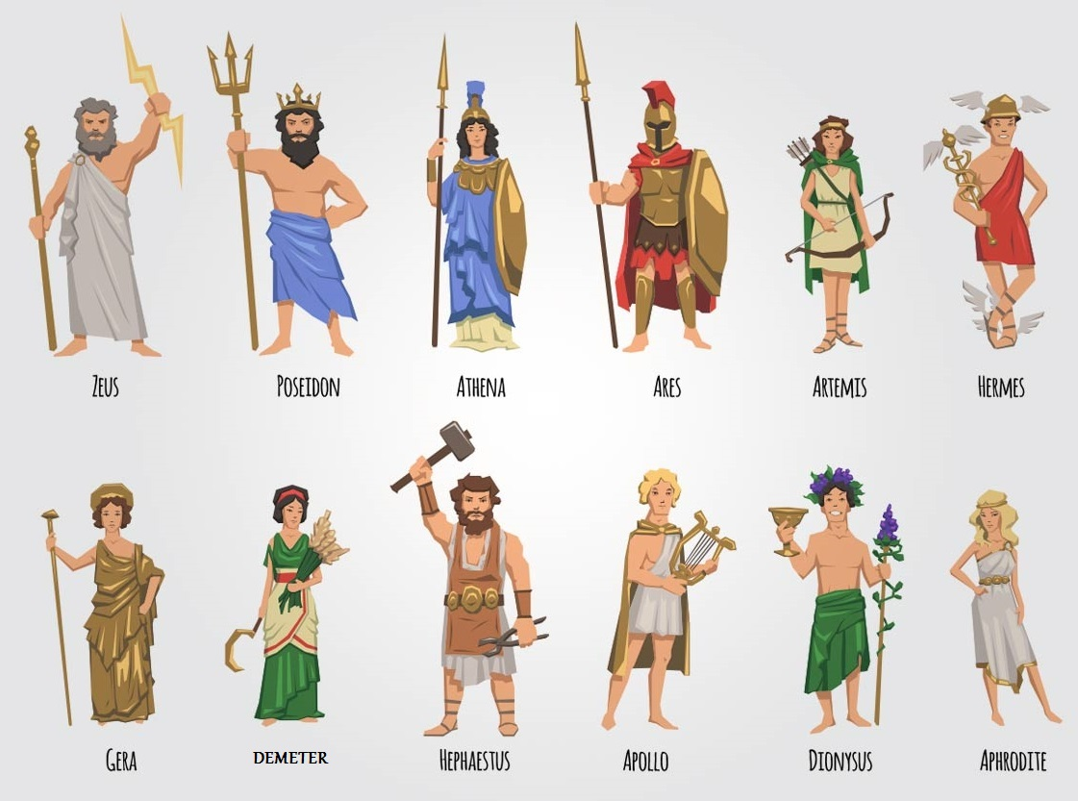
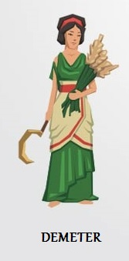
The 12 Gods of Olympus

Slide 14
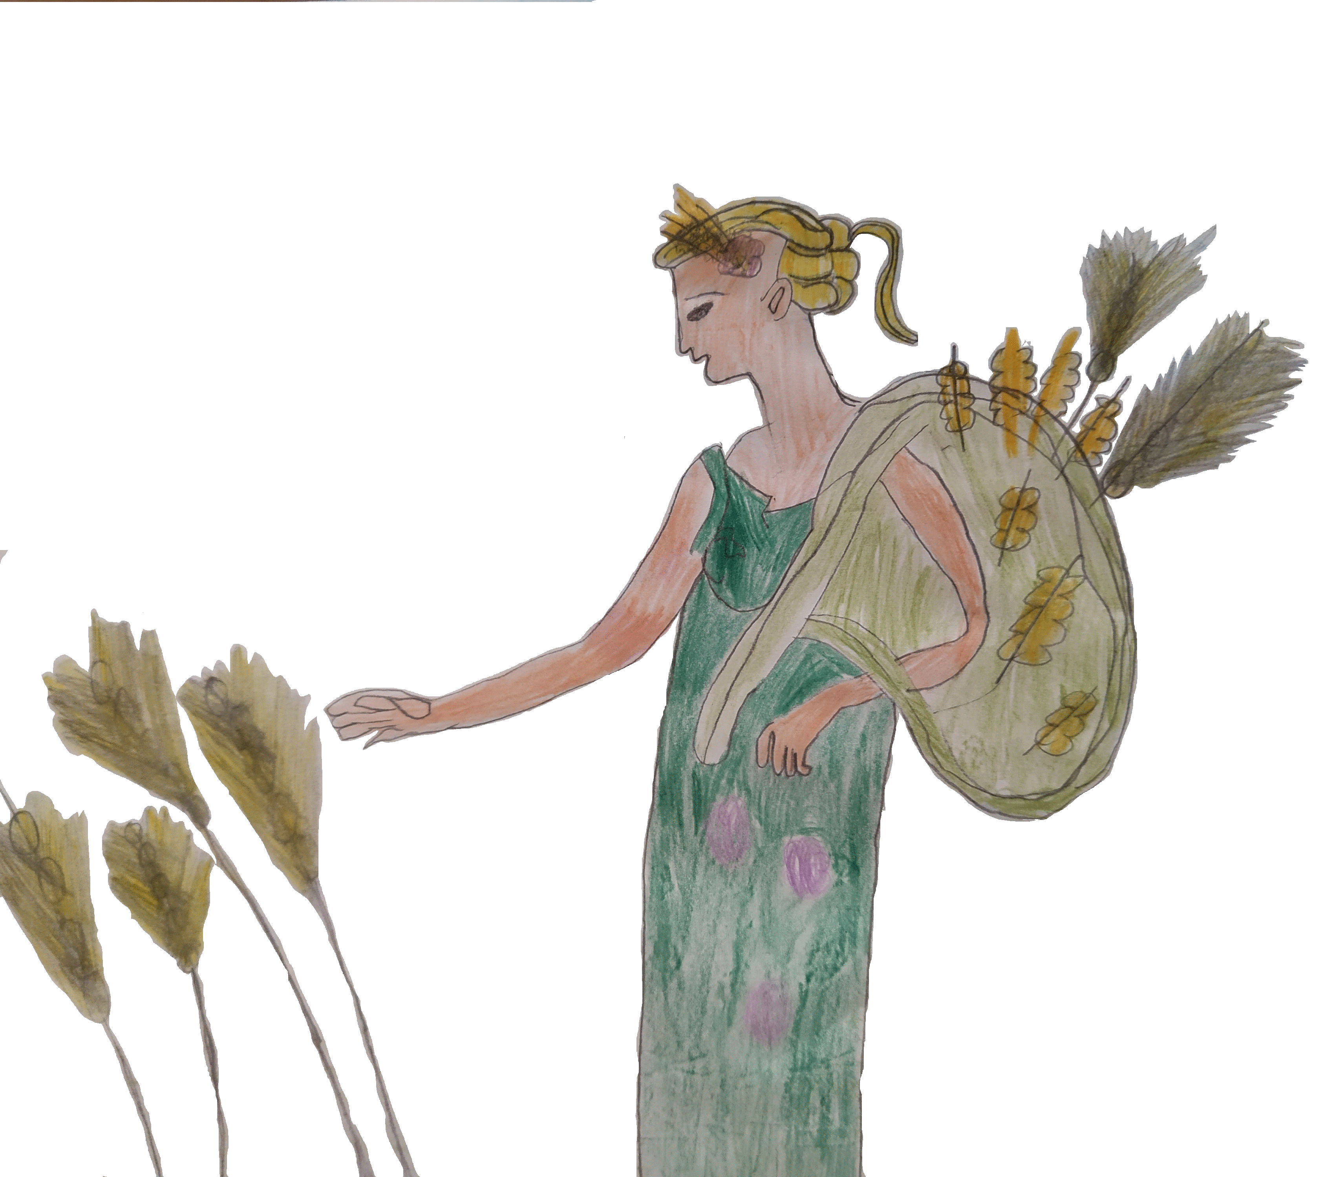
The Goddess Demeter
She was the Olympian goddess of the harvest, agriculture, crops, grains, food and fertility of the earth.
She was the sister of Zeus and the goddess of Offer.
She cared a lot about people. She showed people how to cultivate the earth and take the crops.

Slide 15
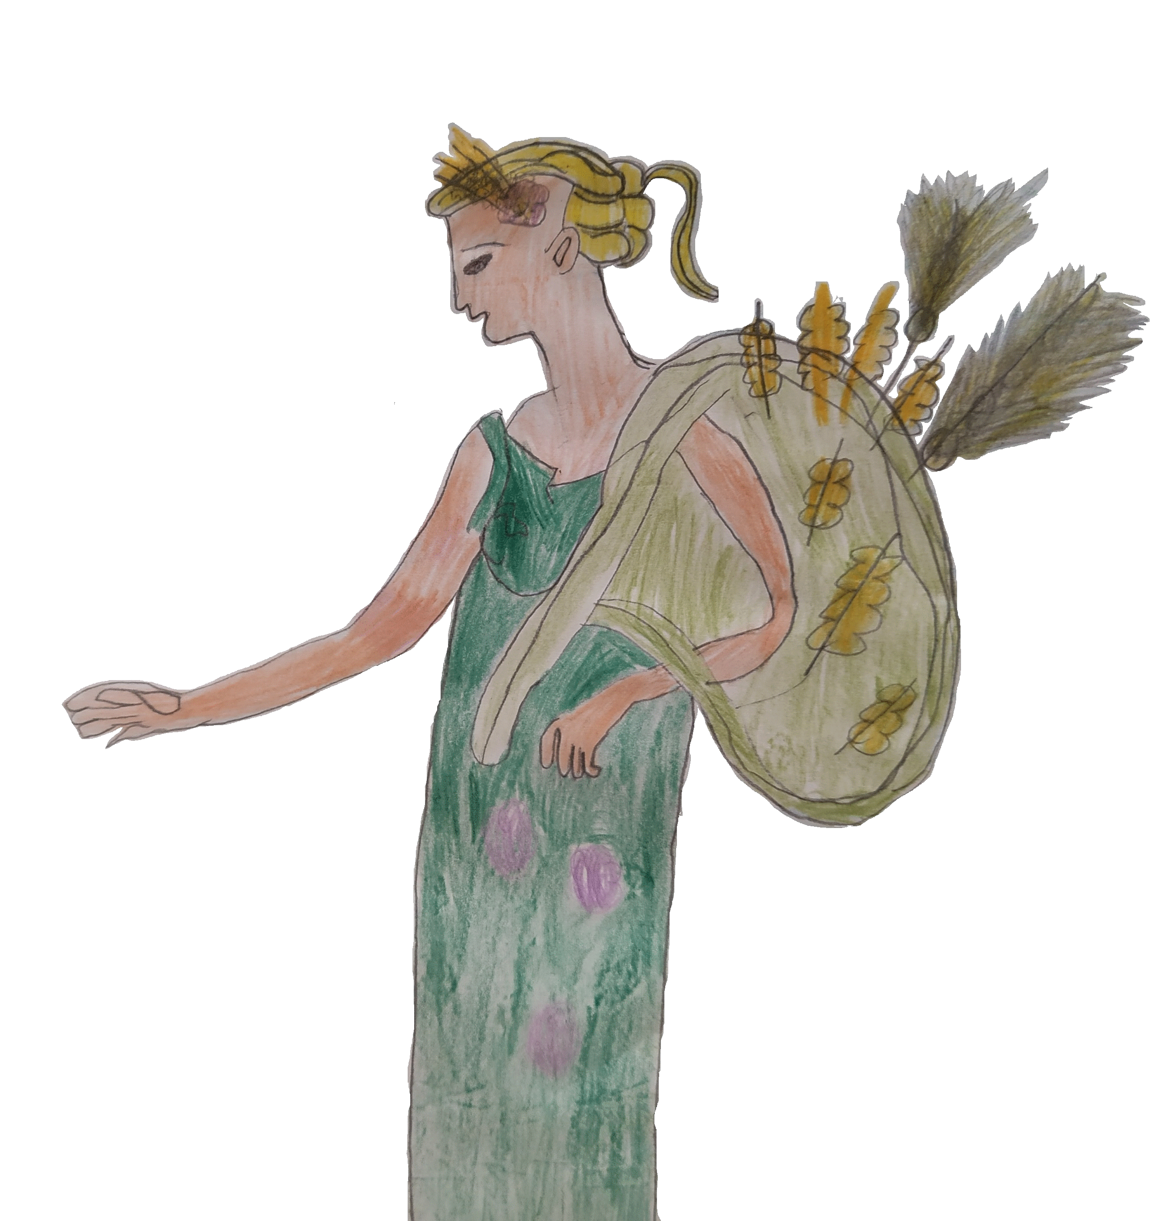
The Goddess Demeter
She was beautiful, tall, thin and smart.
She had blonde hair in braids. She had a wreath made of straw over her head.
It was a symbol of fertility.
Also she was holding straws in her hands.
Her dress was a long green one, like the grass of the earth.

Slide 16
The Goddess Demeter
She had a daughter, the beautiful Persephone. Demeter loved her very much.
But the king of Underworld “Hades” abducted Persephone.
When she lost her daughter, she was very upset and very sorry. She couldn’t find her and a deadly famine started on the earth where nothing would grow again.

Slide 17
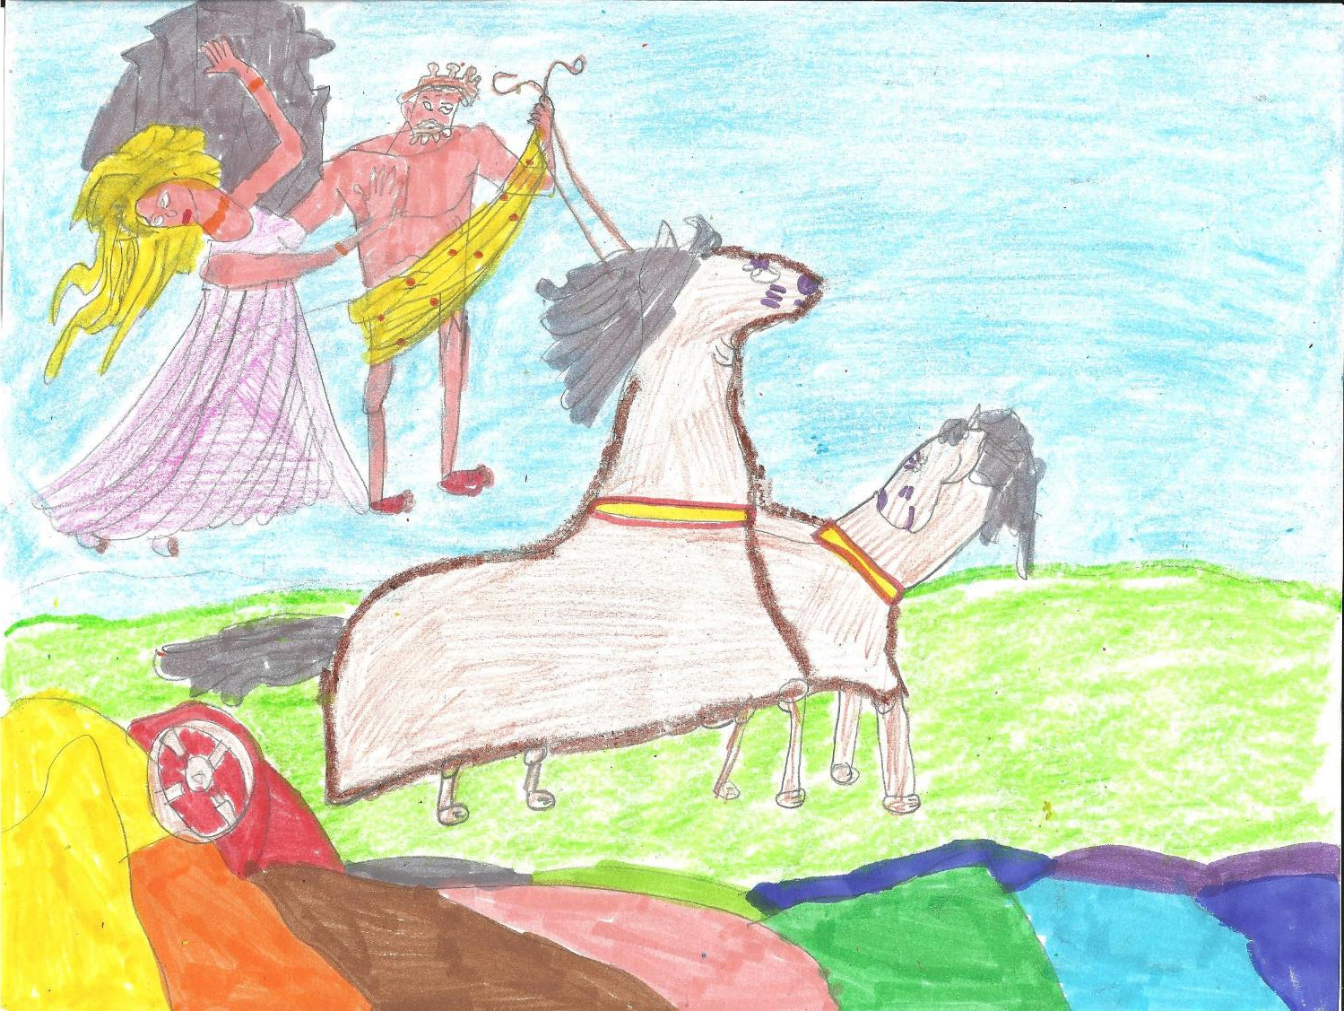
The abduction of Persephone

Slide 18
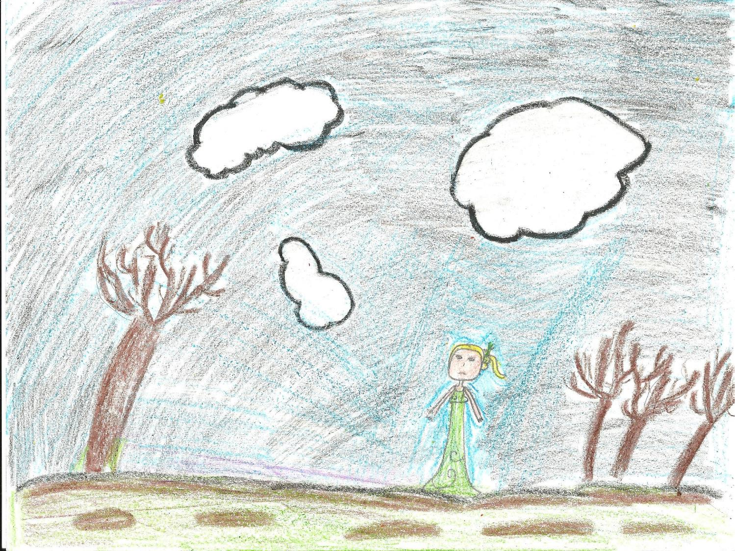
The abduction of Persephone

Slide 19
The Goddess Demeter
Zeus persuaded Hades to let Persephone to return to her mother for six months only, every year.
So, when Persephone is with her mother, Demeter, the earth is flourishing and gives its fruit in Spring and in Summer.
But during the months that Persephone is in the Underworld, Demeter mourns and so does the earth. Since then, there are four seasons of the year.

Slide 20
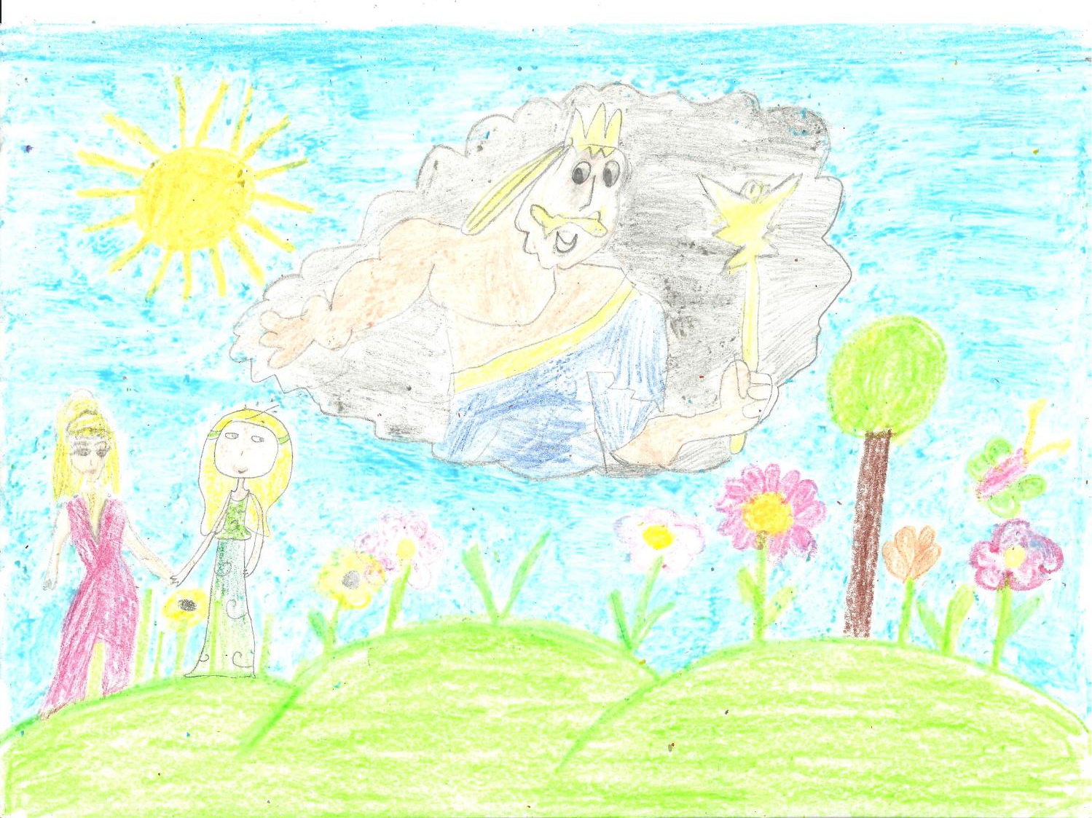
Spring and summer

Slide 21
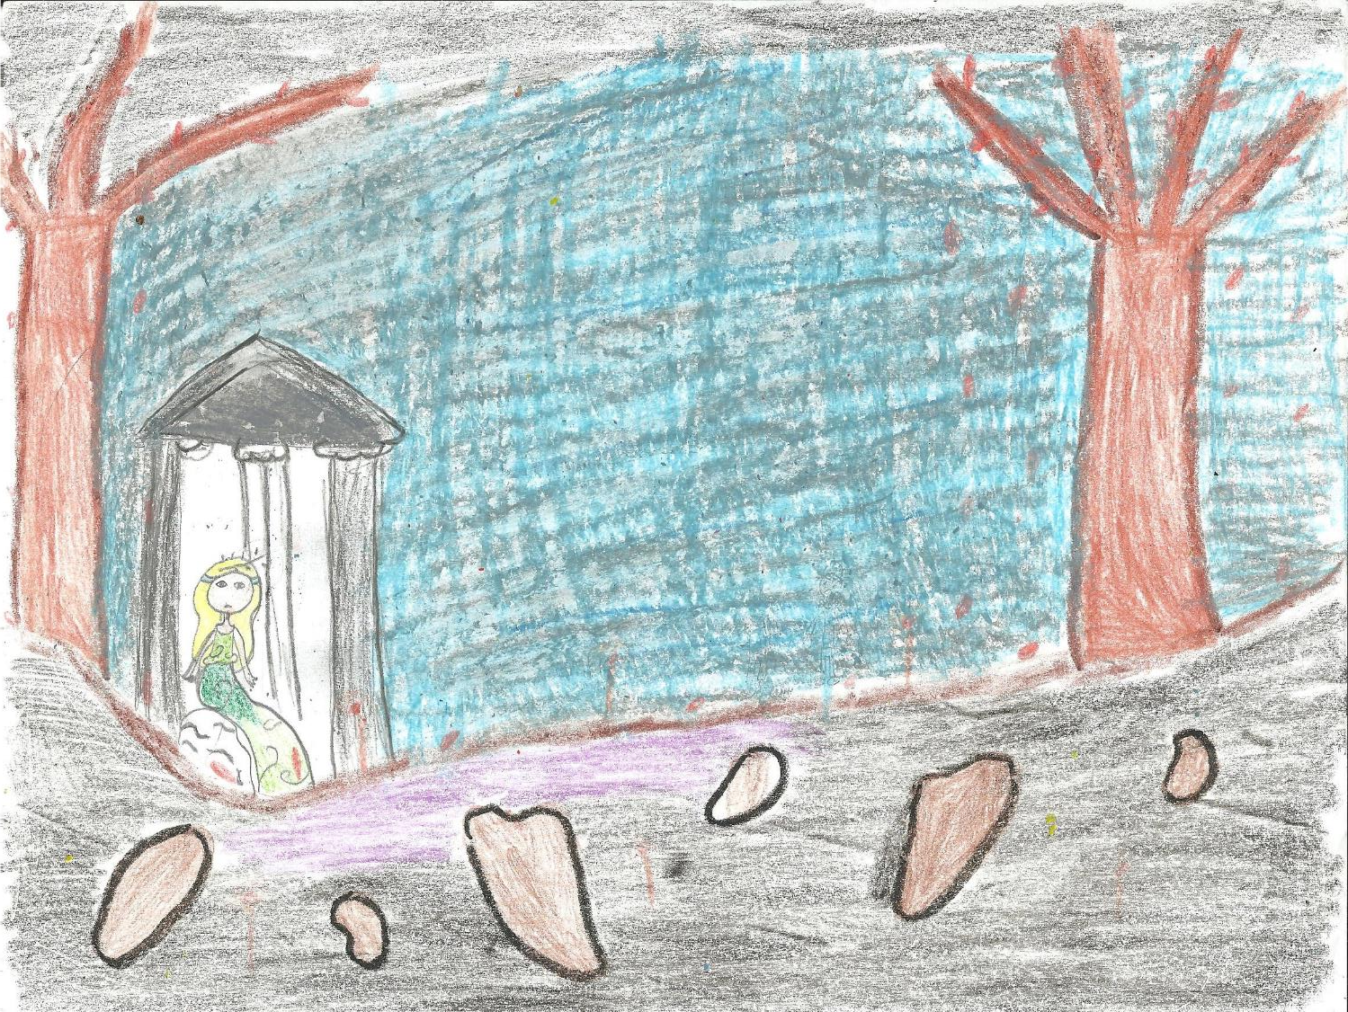
Autumn and Winter

