Slide 1
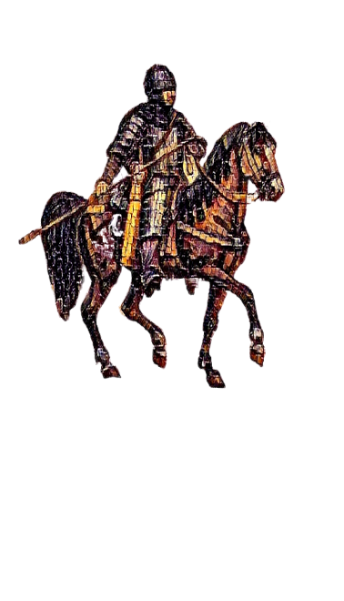
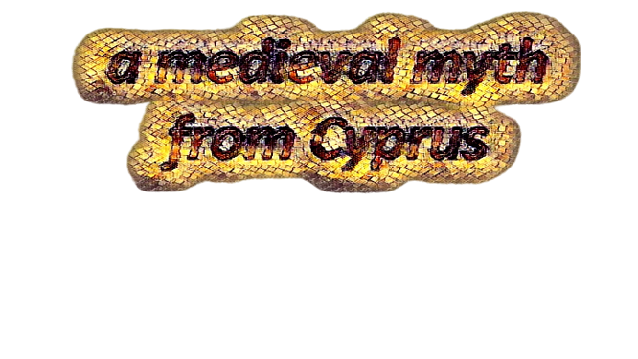

Slide 2
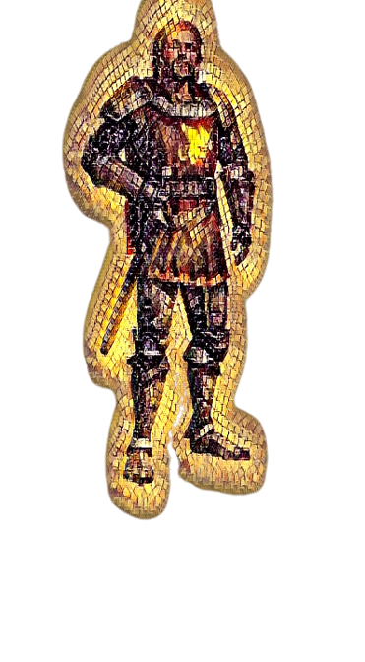
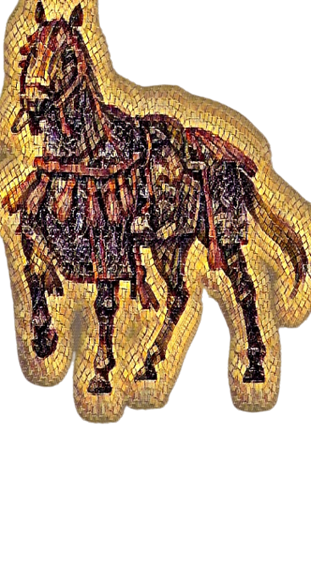
In the 7th century, AD the Eastern Roman (Byzantine) Empire was in war with the Arabs. In order to protect Cyprus, the emperor Heraclius built new forts and sent well trained soldiers to guard the island. These were called Akrites (Milites Limitaneos = Border Guards).
There are numerous folk songs that praise the Akrites on their courage and deeds. Most of these songs narrate the feats of the heroic Digenis Akritas. These folk songs always attribute super-natural powers and traits to the adored protector of the people and greatly exaggerate his accomplishments.

Slide 3
According to those songs, Digenis was the fearless protector of the weak, the scared and the oppressed people. He was strong and athletic and used to compete with the other border-guards in games and sports. He was a farmer, yet he would regularly band in battle with the other Akrites against the invading enemies of the Empire, or even scare them off alone, at times.
He had average height, dark skin tone, broad shoulders, long fingers and narrow teeth… He was not very good-looking, but he really was impressive. He always mounted Mauro, his black war-horse, who was as fast as the wind…

Slide 4
According to one of the legends, Digenis Akritas had scared away a band of Arab Saracen pirates, singlehandedly. The scared pirates fled to their ships, waiting on a coast near Paphos. Digenis stood on the top of Troodos mountain, grabbed a massive rock with his hand and threw it against them, crashing and sinking their pirate ships…
Another medieval song, narrates how Digenis Akritas saved the land from the Gargantuan Crab, a vicious monster that had set his lair in a reedbed marshland. The monstrous creature attacked and terrorised the peasants who approached the river to get water. Digenis managed to kill it, with some help and guidance from God.

