Slide 1
APHRODITE
THE GODDESS OF BEAUTY

Slide 2
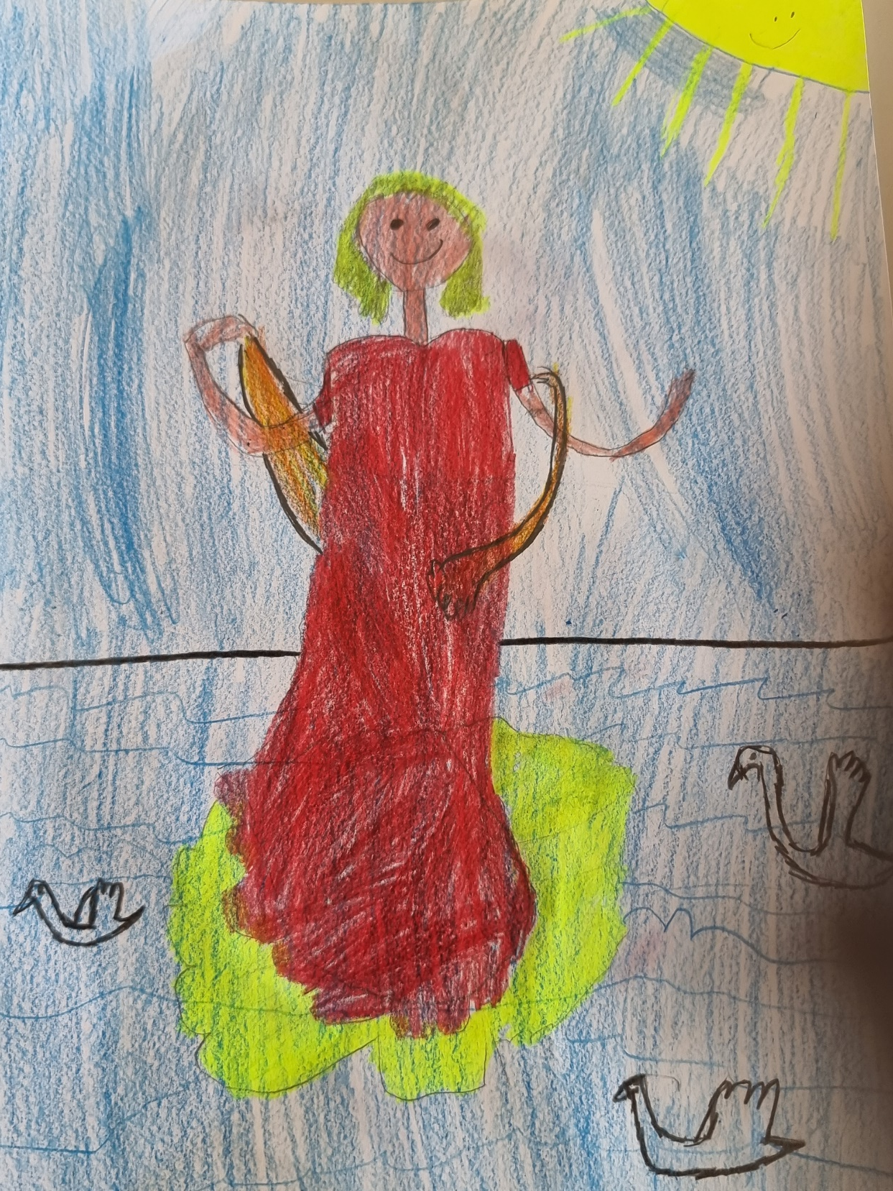
Aphrodite was born off the white foams of the sea. People believed that she was carried to the shore in a shell, which was dragged by birds. This opened on the shores of Paphos and Apfrodite came out of it.

Slide 3
Προσθέστε τίτλο διαφάνειας - 4
Apfrodite was beautiful!
The gods of Olympus themselves were dazzled by her beauty.

Slide 4
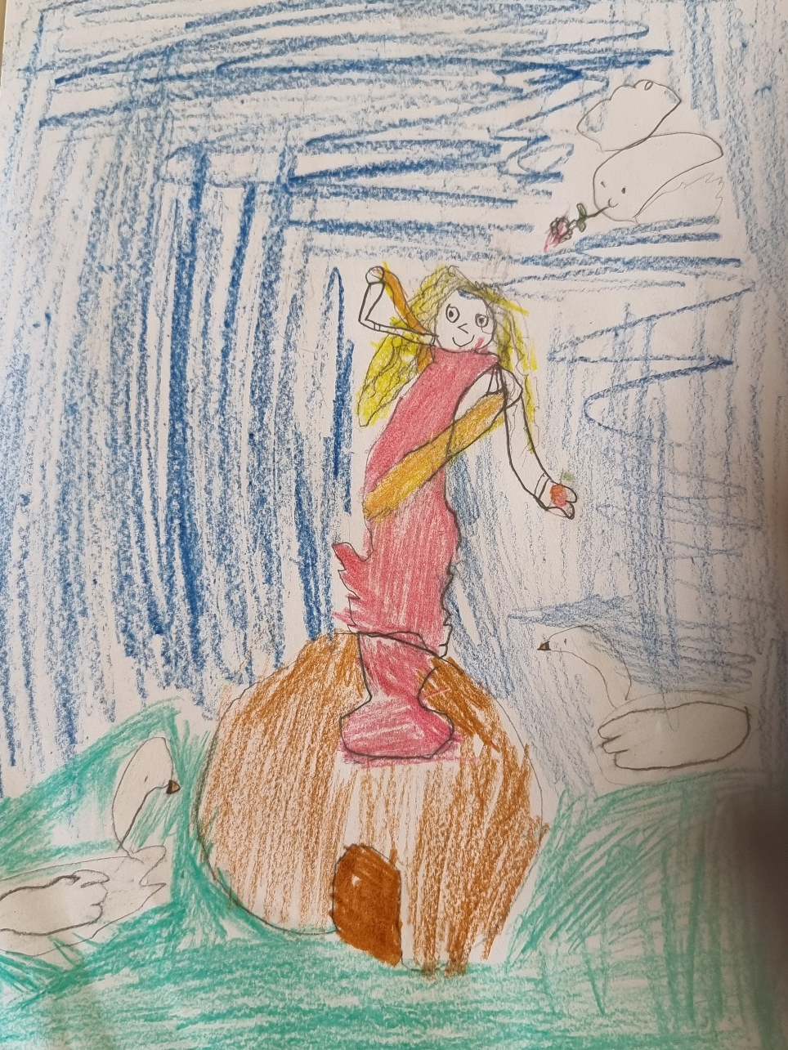
Many men fell in love with beautiful Apfrodite. Among them, there were powerful Gods, but also mortal men, heroes, warriors and artists.

Slide 5
Aphrodite’s most well known love story was with Adonis. When Aphrodite saw the beautiful boy, she took him and locked him in a box, so that no one else would steal him from her. She then, gave the box to goddess Persephone to hide it, until the boy had grown up. But, when Persephone opened the box, she wanted to keep the handsome boy for herself.

Slide 6
This was goddess Apfrodite! Goddess of love and happiness!

